Slide 1
Web Scrapping
With Yahoo Finance
BY Vidya More

Slide 2
What is Web Scraping ?
Web Scraping (also termed Screen Scraping, Web Data Extraction, Web Harvesting etc.) is a technique employed to extract large amounts of data from websites whereby the data is extracted and saved to a local file in your computer or to a database in table (spreadsheet) format.

Slide 3
BeautifulSoup
It is a python library to pulling data out of HTML and XML files. It works with your favorite parser to provide idiomatic ways of navigating, searching, and modifying the parse tree. It commonly saves programmers hours or days of work

Slide 4
pandas: powerful Python data analysis toolkit
pandas is a Python package providing fast, flexible, and expressive data structures designed to make working with “relational” or “labeled” data both easy and intuitive. It aims to be the fundamental high-level building block for doing practical, real world data analysis in Python.
The two primary data structures of pandas, Series (1-dimensional) and DataFrame (2-dimensional), handle the vast majority of typical use cases in finance, statistics, social science, and many areas of engineering

Slide 5
Matplotlib
Matplotlib is a Python 2D plotting library which produces publication quality figures in a variety of hardcopy formats and interactive environments across platforms. Matplotlib can be used in Python scripts, the Python and IPython shell, the jupyternotebook, web application servers, and four graphical user interface toolkits.

Slide 6
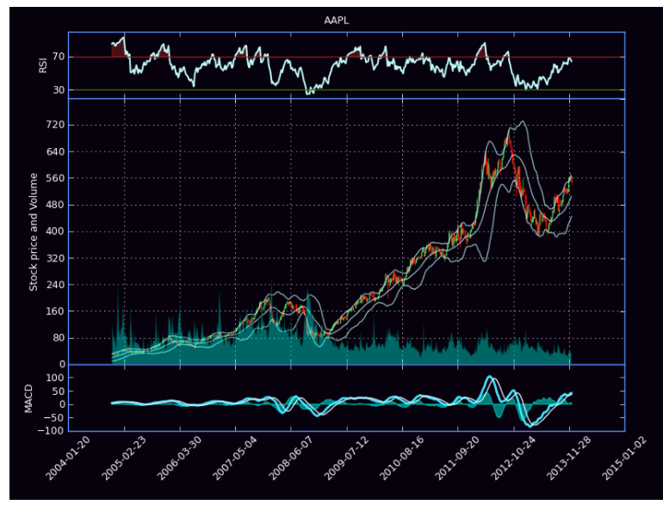
Objective
Grab the stock history data and display it.
It can be used to build a chart like this one.

Slide 7
RESOURCES
https://finance.yahoo.com/
https://www.crummy.com/software/BeautifulSoup/
http://pandas.pydata.org/
https://stackoverflow.com/

